Slide 1
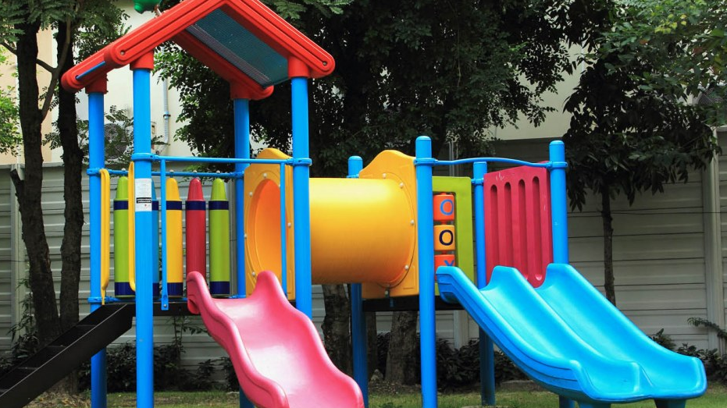
ROWINGTON PARISH COUNCIL PUBLIC CONSULTATION HAVE YOUR SAY ROWINGTON PLAYING FIELD – FUTURE PLANS
You are invited to a Public Consultation at Rowington Village Hall on
Thursday 24 March 2022
Call in between 7.00pm and 9.00pm
Rowington Parish Council is holding a Public Consultation on Thursday 24 March 2022 at Rowington Village Hall and all Parishioners are encouraged to attend
The Parish Council is currently considering the following proposed improvements to the Playing Field:
Play area improvements, outdoor adult gym equipment, community orchard space, wildflower planting for biodiversity and an all-weather footpath
Village Gateway Signage will also be considered
This is your chance to put forward your ideas
This is an informal drop in session and you can call in any time between 7.00pm and 9.00pm to share your views on the plans for the playing field
Light refreshments will be available
If you are unable to attend the meeting, please submit your views to
clerk@rowingtonpc.org.uk

