Slide 1
Warwick District Council
Presentation to Councillors
30th October 2024
Andy Hobbis – andy.hobbis@dwp.gov.uk
Mary Dunleavy – mary.dunleavy@dwp.gov.uk

Slide 2
Agenda
Move to Universal Credit
Labour Market
Support available from DWP
DWP Priorities for 2024/5
Pension Credit

Slide 3
Move to Universal Credit
Universal Credit is replacing 6 benefits called ‘legacy benefits’. These are:
Tax credits: Working Tax Credit and Child Tax Credit
Housing Benefit
Income-related Employment and Support Allowance (ESA)
Income-based Jobseeker’s Allowance (JSA)
Income Support
Other benefits, such as Personal Independence Payment (PIP), will stay the same.
Move to Universal Credit if you get a Migration Notice letter - GOV.UK (www.gov.uk)

Slide 4
Expansion Plans – Working Age
Once Move to UC has completed geographical expansion with Tax Credits, all UC jobcentres and service centres will be live and fully trained in key principles of move. Further expansion into other Working Age Benefits will be by line of Benefit rather than any Geographical expansion, with an expansion plan based on our findings from our discovery locations, retaining the key principle of moving customers in a safe way.
Following the recent Prime Minister’s announcement, expansion previously scheduled to begin in 2028 will now commence from September 2024. Planning is now underway to assure the safe migration of these customers.
Dec 2025
ESA (IR)
ESA (IR) & Housing Benefit

Slide 5
Customer Support Journey
Identify people to move
Contact people / issue a MN
People successfully make a claim before their deadline date
The UC award is paid in full and on time for people that have moved
UC claim not made
No claim journey
Reminder(s)
UC claim made
Match claimant
Stop legacy benefits
Apply TP eligibility rules
Retrieve data to calculate TE
Calculate TE
Claimant receives first payment
TE erodes and/or ends
Select sample of claimants
Issue migration notice
Claimant receives migration notice
Self-serve guidance via GOV.UK
Do support journey
Claimant needs support
Enhanced Support Journey offered to Vulnerable/IS customers and customers with IRO ESA
Dedicated telephone line
Refer to onward support

Slide 6
The Move Support Journey
Customer Answers Calls
Supported to make their claim.
Migration Notice Issued
1st Reminder issued (7 weeks after MN issued)
2nd Reminder Issued 2 Weeks before Closure Date
1 Week following final reminder, SMA message, advising they will receive a call from the department.
If No Mobile number will complete calls “cold”.
The following 3 days we will attempt 3 calls over those 3 days and various points in the day.
Customer fails to Answer/Respond
A full case review on their claim, checking DWP accessible systems, to identify any complex needs
Between Migration Notice issue and potential closure, a vulnerable customer will receive at least 10 attempted contacts, by various methods.
If at any point we identify a vulnerability that would require, or if support Journey requires, we will extend customers potential closure date. This will allow time to offer relevant support and ensure Transitional Protection, and 1 month grace period in the event of a closure.
Customers where no evidence of vulnerability.
Subject to previously established case closure process.
Visit Unsuccessful.
New role in live testing, to fully review all steps taken, evidence of vulnerabilities
IS customers with an identified Vulnerability and Customers IRO of an ESA component.
Referred to visiting officer, where will attempt 3 visits.
Visit Successful.
Customer supported/Signposted to relevant support to make claim

Slide 7
Move to UC Latest Update
As with other benefits the notices will be issued randomly across the country not on a geographical basis.
By the end of September 2024 all Mandatory Notifications have been issued for all benefit types, with the exception of deferred/complex customers and Employment Support Allowance (ESA).
From October the ESA migration journey has started with small numbers to test issues that may arise.

Slide 8
Labour Market – Warwick District
Employment Picture in Warwick District is still buoyant.
Warwick currently has one of the highest employment rates in the country, currently 86.0% (Annual Population Survey July 2023 to June 2024) compared to a West Midlands region rate of 74.7%. There has been really strong growth - the employment rate rose by 10.7 percentage points over the past year.
It equates to an additional 8,900 working age people finding employment to a total of 75,900. Thank you to the Council for your support with Jobsfairs at the Pump Rooms- it has made a difference.
Kenilworth and Southam constituency has the lowest Claimant Count rate of anywhere in the region – only 1.9% of the working age population. The rate in Warwick and Leamington is just 2.8%.

Slide 9
Labour Market – Warwick District
Although youth unemployment is low, the aged 18-24 Claimant Count across Warwick District has risen quite noticeably over the past year. The rise from 300 to 375 (September 2023 to September 2024) is 25% - the largest proportional growth in the region.
Economic inactivity in Warwick District is low – just 12.5% of the working age population are out of work and not looking for work (regional average 22.3%) (Annual Population Survey July 2023 to June 2024).
Around 3,000 working age people in Warwick are estimated to be inactive due to long-term sickness – this compares to a Claimant Count of 2,320.

Slide 10
Support from your local Jobcentre
There is a wide range of support available to customers in the Jobcentre with a robust offering on a weekly basis.
National Careers Service
CV Support
Careers Planning
Restart
Universal Credit customers in the intensive work group who are claiming for six months are required to enrol with the Restart programme. The programme will provide up to 12 months of tailored support for each participant. In this area it is PET – Xi who are the provider.
Non contracted provision
A range of provision funded through Adult Education Budgets, or UKSPF funding.
Examples. CSCS cards
SIA Licences
Food & Hygiene Certificates

Slide 11
DWP Priorities for 2024/5 in Mercia
Development of Place Based Plans
We are developing place-based plans that builds a picture of the changing labour markets across Leamington, Warwick and Kenilworth, ensuring we have the support available to meet Jobseeker need.
Support for the Over 50’s - JCP Mid-life MOT
The Mid-life MOT is a check of health, skills and finances for people in their 50s to help them plan for later life.
Mid-life MOT’s are built upon three core themes - Work, Wealth and Wellbeing, they are delivered in a group information session setting and are voluntary.
They are designed to help Universal Credit 50+ claimants consider:
Ways to overcome barriers to employment
The benefits to improving earnings and savings potential
Retirement planning

Slide 12
DWP Priorities for 2024/5 in Mercia
Support for those with health conditions and disabilities
Health & Wellbeing Event for Jobseekers
6th November – Fred Winter Centre, Stratford Upon Avon
Focus on Health & Wellbeing information, organisations like Mind, Recovery Academy, Healthwatch will be coming together with Housing Associations and others to offer support to residents.
Supporting those in work – in work progression
A number of Work Coaches in DWP now have a dedicated role to offer additional support to customers who are working and want additional support to increase hours and their financial capability. The support is voluntary and customers in the Light Touch or Working Enough will be initially offered the support.
Addressing skills needs for example use of Multiply.

Slide 13
DWP Priorities for 2024/5 in Mercia
Support for 18 – 24 year olds
With an increase in Youth Unemployment we will be utilising the new Warwickshire County Council – Future Destination Support through UKSPF
Princes Trust

Slide 14
Pension Credit
Pension Credit gives you extra money to help with your living costs if you’re over State Pension age and on a low income. Pension Credit can also help with housing costs such as ground rent or service charges.
Extra money to help with your living costs;
Must be over State Pension age and on a low income.
Can also help with housing costs such as ground rent or service charges
Can claim even if have savings or are a homeowner
Pension Credit tops up: your weekly income to £218.15 if you’re single your joint weekly income to £332.95 if you have a partner
When calculating entitlement to Pension Credit, income includes:
State Pension, other pensions, some benefits (such as Carer’s Allowance) and any earnings
Income does not include Attendance Allowance; Child Benefit; Housing Benefit
Notes:
You must include your partner on your application.
You’ll be eligible if either:
you and your partner have both reached State Pension age
one of you is getting Housing Benefit for people over State Pension age
A partner is either:
your husband, wife or civil partner - if you live with them
someone you live with as a couple, without being married or in a civil partnership
Your income
When you apply for Pension Credit your income is calculated. If you have a partner, your income is calculated together.
If your income is higher, you might still be eligible for Pension Credit if you have a disability, you care for someone, you have savings or you have housing costs.
What counts as income
Your income includes:
State Pension
other pensions
earnings from employment and self-employment
most social security benefits, for example Carer’s Allowance
What does not count as income
Not all benefits are counted as income. For example, the following are not counted:
Adult Disability Payment
Attendance Allowance
Christmas Bonus
Child Benefit
Disability Living Allowance
Personal Independence Payment
social fund payments like Winter Fuel Allowance
Housing Benefit
Council Tax Reduction

Slide 15
How to Claim Pension Credit
Can start claim 4 months before reach State Pension Age
Can apply at any time after reaching State Pension age but Pension Credit can only be backdated by 3 months
Apply online on GOV.UK Pension Credit: How to claim - GOV.UK (www.gov.uk)
Apply by phone - A friend of family member can call for you if you cannot use the phone
Apply by post – print out and complete claim form or call claim line to ask for a form
Pension Credit claim line: 0800 99 1234 Textphone: 0800 169 0133 Relay UK (if you cannot hear or speak on the phone): 18001 then 0800 99 1234 British Sign Language (BSL) video relay service if you’re on a computer Open: Monday to Friday, 8am to 6pm
Organisations like Citizen’s Advice and Age UK can help with completing the claim form
Notes:
If you have a severe disability
You could get an extra £81.50 a week if you get any of the following:
Attendance Allowance
the middle or highest rate from the care component of Disability Living Allowance (DLA)
the daily living component of Personal Independence Payment (PIP)
Armed Forces Independence Payment
the daily living component of Adult Disability Payment (ADP) at the standard or enhanced rate
If you care for another adult
You could get an extra £45.60 a week if:
you get Carer’s Allowance
you’ve claimed Carer’s Allowance but are not being paid because you already get another benefit paying a higher amount
If you and your partner have both claimed or are getting Carer’s Allowance, you can both get this extra amount.
If you’re responsible for children or young people
You could get an extra £66.29 a week for each child or young person you’re responsible for. This is increased to £76.79 a week for the first child if they were born before 6 April 2017.
The child or young person must normally live with you and be under the age of 20.
If they’re 16 or over and under 20, they must be in (or accepted for):
approved training, such as Foundation Apprenticeships
a course of non-advanced education (for example, they’re studying for GCSEs or A levels)
If they’re in education, it must be for more than 12 hours a week on average.
If you get Tax Credits, you cannot get this extra amount of Pension Credit for caring for a child. But you might be eligible for Child Tax Credits.
If the child or young person is disabled
If the child or young person is disabled, you could also get an extra amount of either:
£35.93 a week if they get DLA, PIP or ADP
£112.21 a week if they’re blind or they get the highest rate care component of DLA or CDP, or the enhanced daily living component of PIP or ADP
If you have housing costs
You could get an extra amount to cover your housing costs, such as:
ground rent if your property is a leasehold
some service charges
charges for tents and site rents
The amount you could get depends on your housing costs.
If you get Pension Credit, you could also be eligible for:
Council Tax Reduction
Housing Benefit if you rent the property you live in
Support for Mortgage Interest if you own the property you live in
If you have savings or a second pension
You could get the ‘Savings Credit’ part of Pension Credit if both of the following apply:
you reached State Pension age before 6 April 2016
you saved some money for retirement, for example a personal or workplace pension
You’ll get up to £17.01 Savings Credit a week if you’re single. If you have a partner, you’ll get up to £19.04 a week.
You might still get some Savings Credit even if you do not get the Guarantee Credit part of Pension Credit.
Other help if you get Pension Credit
If you get Pension Credit you’ll automatically get cold weather payments.
You’ll also be eligible to:
apply for a free TV licence if you’re aged 75 or over
get help with NHS costs if you get the Guarantee Credit part of Pension Credit
NHS costs can include things such as prescriptions, dental treatment, glasses and transport costs for hospital appointments.

Slide 16
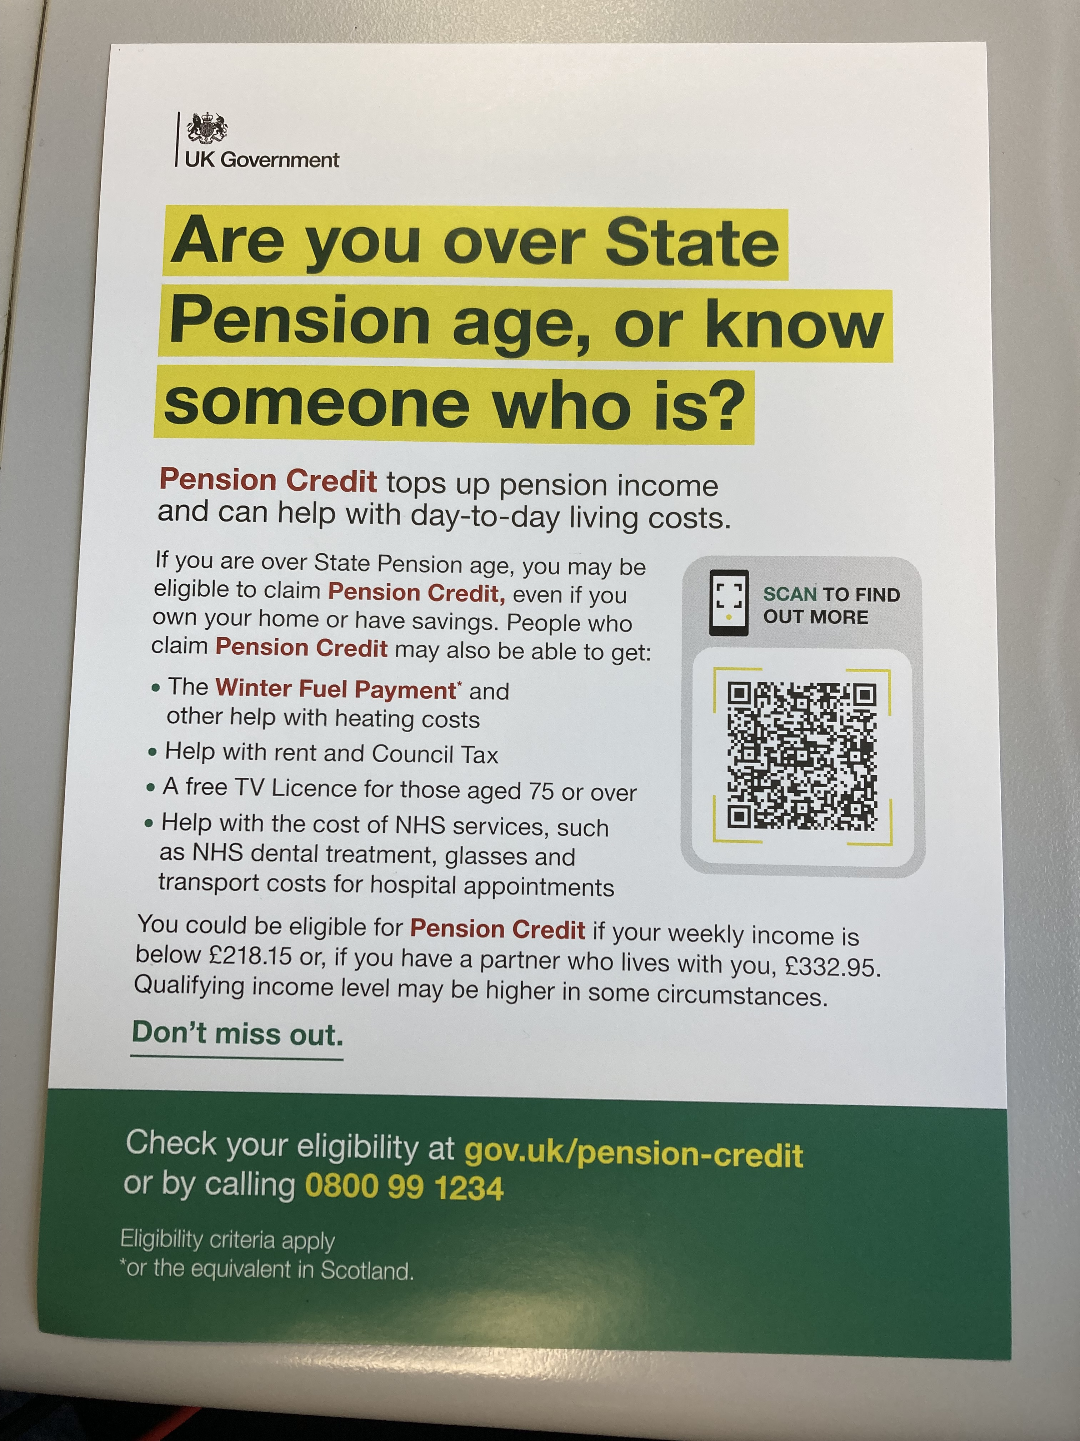
Pension Credit Help
DWP are currently running a campaign to encourage individuals to check whether they are entitled to Pension Credit.
Pension Credit toolkit: advice and guidance for stakeholders - GOV.UK (www.gov.uk)
Notes:
Apply by post
To apply by post, print out and fill in the Pension Credit claim form or call the claim line to request a form.
Send the claim form to the Pension Service, or ask someone to do it for you.
The Pension Service 8 Post Handling Site B Wolverhampton WV99 1AN
Contact a voluntary organisation like Citizens Advice or Age UK if you need help with the form.
If you disagree with a decision
You can challenge a decision about your Pension Credit application. This is called asking for mandatory reconsideration.

Slide 17
Thankyou for Listening
Any Questions.
Information is correct as of 25th October 2024
Always check Gov.uk for latest updates.

